Slide 1
Cibercrime Instrumentos do Cibercrime
Seminário
2019
Nuno Santos

Slide 2
Cibercrime
“Todo e qualquer acto ilegal envolvendo um computador, os seus sistemas, ou as suas aplicações” (EC-Council)
EC-Council: International Council of Electronic Commerce Consultants
Compreende um conjunto de delitos definidos em leis como:
The U.S. Computer Fraud
The UK Computer Abuse Act
Lei do Cibercrime, in Portugal
Notes:
http://legaldictionary.net/cybercrime/
Criminal activity that entails the use of a computer system, computer technology, or the internet.
Cybercrime is now defined as any criminal offense that is facilitated by, or involves the use of, electronic communications or information systems, including any electronic device, computer, or the internet.

Slide 3
Exemplos de cibercrime
Roubo de propriedade intelectual
Roubo de identidade
Fraude de identidade
Fraude financeira
Cyberbullying e cyberstalking
Pornografia infantil
Ciber extorsão
Ataques de negação de serviço
Intrusão em sistemas
Instalação de programas maliciosos (malware)
Notes:
Any act that would allow an individuals to get access to patents, trade secret, customer data, sales trends and any other confidential information that can be of monetary gain
When fraudsters access enough information about someone’s identity (such as their name, date of birth, addresses) to commit identity fraud
The use of stolen identity in criminal activity to obtain goods or services by deception, e.g.: open bank accounts, obtain credit cards, loans and state benefits, order goods in your name, take over your existing accounts
Any type of criminal behavior that uses fraudulent solicitation to prospective victims to conduct fraudulent transactions
The act of harming or harassing via information technology networks in a repeated and deliberate manner
Victims of cyberbullying are children, victims of cyberstalking are adults
Denial of service attacks
Aim at stopping legitimate requests to a network over the Internet by subjecting the network to illegitimate requests
Hacker system penetrations
A network or system penetration occurs when an outsider gets access to the network and changes settings within the network
Planting of malicious programs (malware)
Virus are attached to applications and cannot replicate themselves alone; can affect machines and seek to affect other vulnerable systems
Worms seek to replicate themselves over the network thereby hogging resources apart from creating malfunctions
Trojan horses and backdoors are programs that allow an intruder to retain access to a compromised machine

Slide 4
Cibercrime in Portugal: Lei do Cibercrime
Lei n.º 109/2009, de 15 de Setembro
http://goo.gl/PTg2oj
CAPÍTULO II: Disposições penais materiais
Artigo 3.º: Falsidade informática
Artigo 4.º: Dano relativo a programas ou outros dados informáticos
Artigo 6.º: Acesso ilegítimo
Artigo 8.º: Reprodução ilegítima de programa protegido
Notes:
http://www.anacom.pt/render.jsp?contentId=985560#.V_Kb-JMrI7x

Slide 5
Evolução do cibercrime
Notes:
https://resources.infosecinstitute.com/evolution-in-the-world-of-cyber-crime/#gref

Slide 6


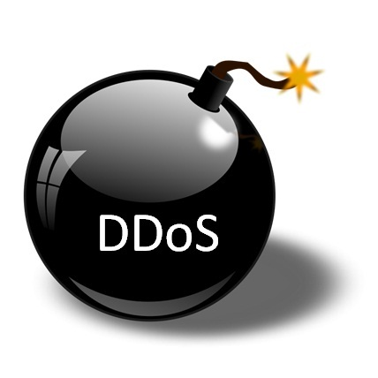

Principais instrumentos do cibercrime
Deep Web
Como encontrar informação e localizer serviços
Ferramentas do Cibercrime
Sistemas de anonimato
Como esconder a ID na Internet
Botnets
Como lançar ataques em larga escala
Criptomoeda
Como tornar os pagamentos não rastreáveis

Slide 7
Deep Web

Slide 8




A Web: Recurso ponderoso para cibercriminosos
Cibercriminoso
Oferece um gigantesto repositório de informação, usado em:
Premeditação de crimes, violações de privacidade, roubo de identidade, etc.
Permite aceder a serviços online para actividade criminosa
Ex., venda de drogas, venda de armas, acesso a pornografia infantil, etc.
Para encontrar esses recursos, existem poderosos motores de busca
Google, Bing, Shodan, etc.
Notes:
WWW: an information system on the Internet which allows documents to be connected to other documents by hypertext links, enabling the user to search for information by moving from one document to another.

Slide 9

A Web: recurso poderoso para investigadores
Investigadores
Poderosa ferramenta para investigação de suspeitos
Provas em blogs, redes sociais, actividade de navegação web, etc.
É a arena em que o próprio crime tem lugar
Transacções ilegais, cyber stalking, extorsão, fraude, etc.

Slide 10
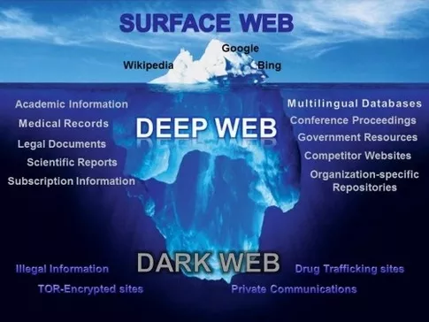
A Web e a analogia do iceberg
Notes:
What’s “visible” through typical search engines is minimal
Deep Web is not necessarily bad: it’s just that the content is not directly indexed
Part of the deep web where criminal activity is carried out is named the Dark Web

Slide 11

A Web de superfície
Surface Web: Parte da Web acessível ao público em geral nos motores de busca convencionais
Outros nomes: Visible Web, Clearnet, Indexed Web, Indexable Web or Lightnet
Em Junho, 2015, o índice da surface web criado pela Google continha cerca de 14.5 biliões de páginas

Slide 12
Como funciona um motor de busca convencional
Muitos (mesmo muitos) computadores
Utilizadores
Interface
Query Engine
Index
Crawler
Indexer
Web

Slide 13
Crawling da Web: A partir de páginas seminais
URLs crawled
and parsed
Unseen Web
Seed
pages
URLs frontier
Web

Slide 14
Google hacking
Google oferece keywords para procuras avançadas
Operadores lógicos em expressões de pesquisa
Atributos avançados de pesquisa: “login password filetype:pdf”
Para saber mais:
http://www.mrjoeyjohnson.com/Google.Hacking.Filters.pdf

Slide 15
Exmplos: Pesquisar tipos de ficheiros sensíveis
filetype: restringe pesquisas ao tipo de ficheiro
filetype:xls “checking account” “credit card”

Slide 16
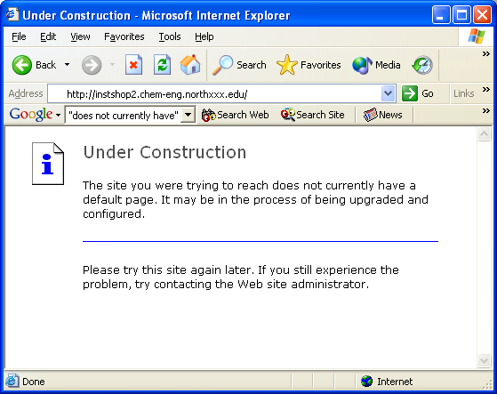
Exemplo: Encontrar servidores expostos
intitle:"Under construction" "does not currently have"
intitle:"Welcome to Windows 2000 Internet Services"

Slide 17
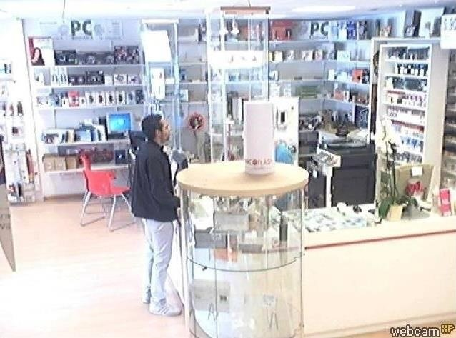
Exemplo: Encontrar webcams expostas
Para encontar webcams não proteginas na Internet, usar a pesquisa seguinte:
inurl:/view.shtml
Também é possível restringir por padrões de URL específicos do fabricante ou modelo
inurl:ViewerFrame?Mode=
inurl:ViewerFrame?Mode=Refresh
inurl:axis-cgi/jpg
...

Slide 18

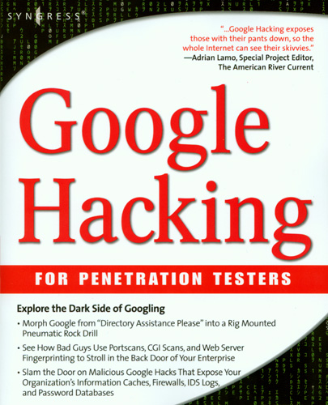
Google hacking: Livros inteiros sobre isto
Dornfest, Rael, Google Hacks 3rd ed, O’Rielly, (2006)
Ethical Hacking, http://www.nc-net.info/2006conf/Ethical_Hacking_Presentation_October_2006.ppt
A cheat sheet of Google search features: http://www.google.com/intl/en/help/features.html
A Cheat Sheet for Google Search Hacks -- how to find information fast and efficiently http://www.expertsforge.com/Security/hacking-everything-using-google-3.asp
Notes:
https://www.blackhat.com/presentations/bh-europe-05/BH_EU_05-Long.pdf

Slide 19
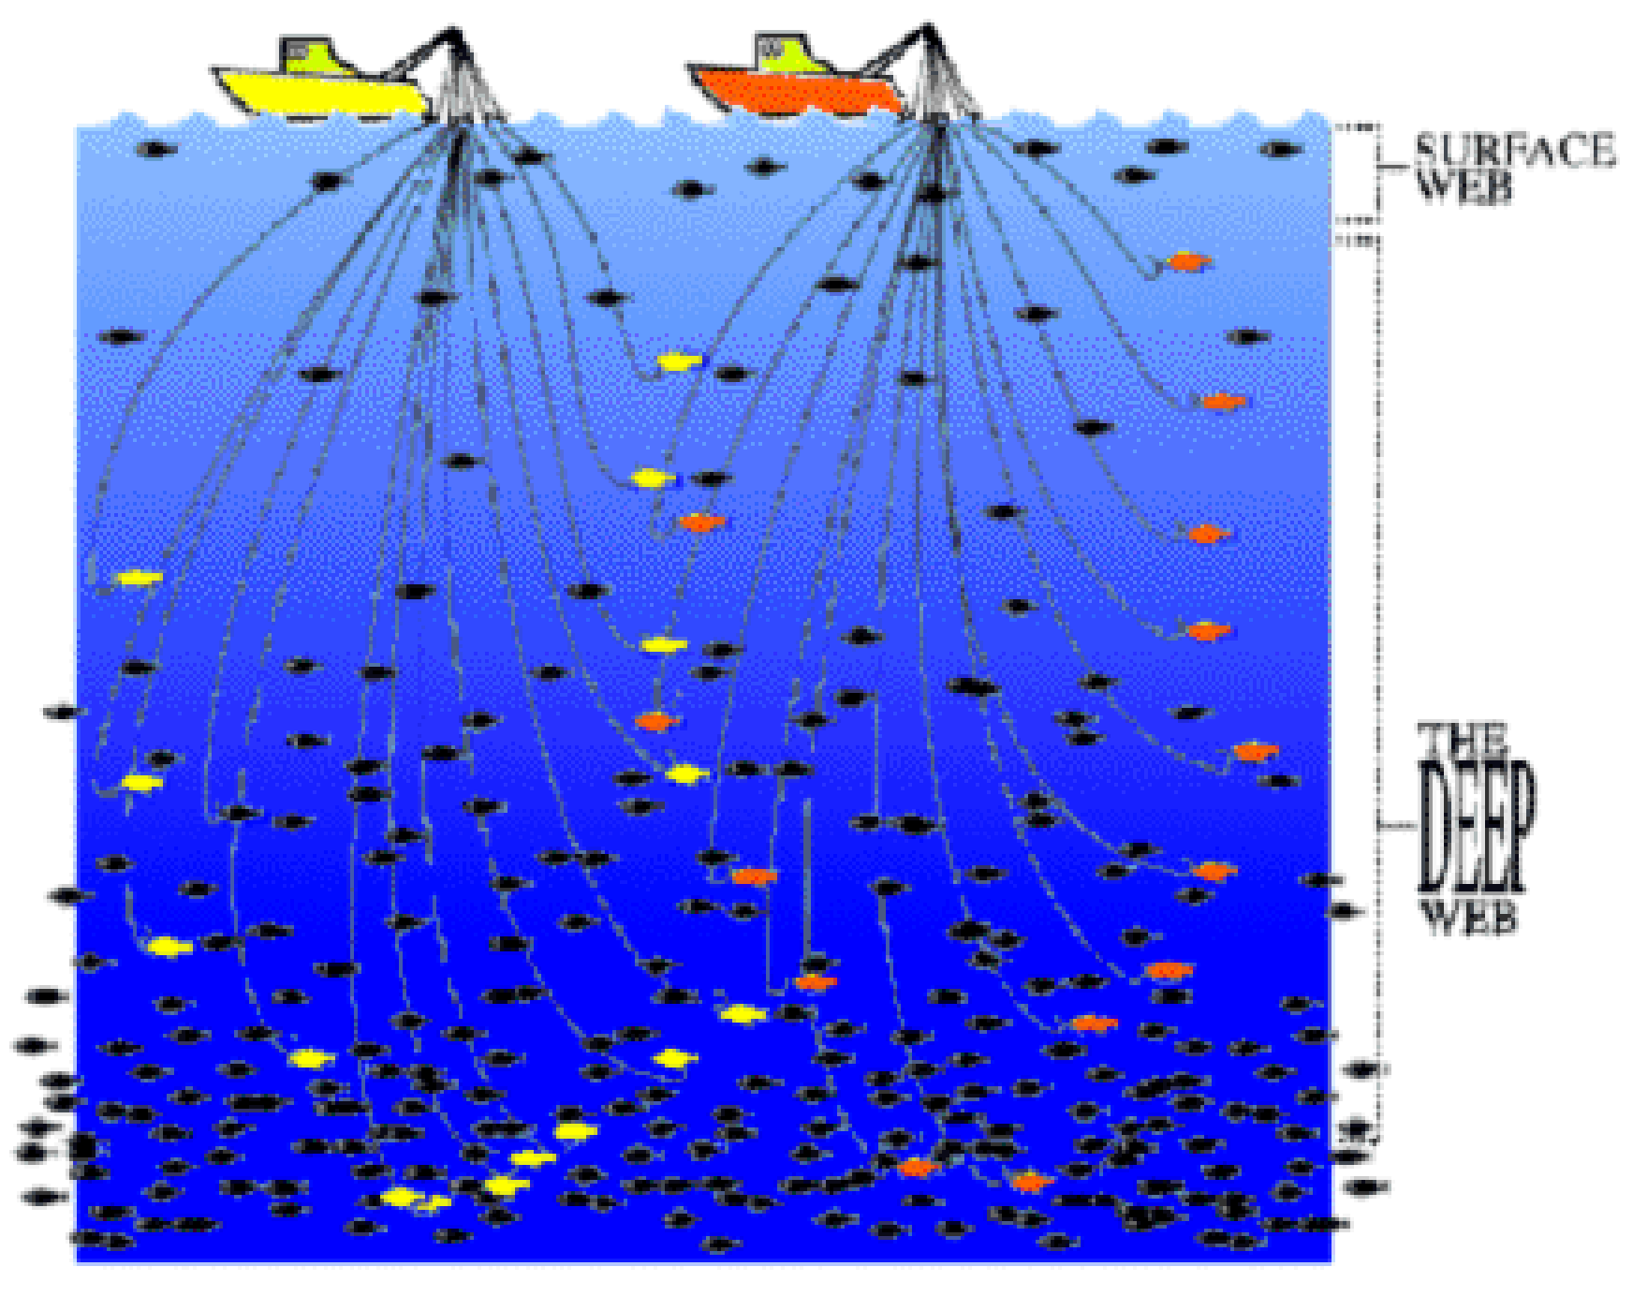
Deep Web
Parte da Web que não é indexada por motores de busca convencionais, logo não aparece nos resultados
Porque não é indexado pelos motores de busca típicos?

Slide 20
Há conteúdo que não pode ser encontrado seguindo os URL
Páginas dinâmicas e buscas em bases de dados
Resposta a pesquisas ou acedidas através de formulários
Conteúdos não referenciados (unlinked)
Páginas sem links para elas (orfãs)
Web privada
Sites que precisam de registo e login
Web de acesso limitado
Sites com captchas, cabeçalhos http no-cache pragma
Notes:
Dynamic (server generated) web pages and searchable databases
Response to a query or accessed only through a form
Unlinked contents
Pages without any links to them (orphan)
Private web
Sites requiring registration and login
Limited access web
Sites with captchas, no-cache pragma http headers
----
The Pragma: no-cache header field is an HTTP/1.0 header intended for use in requests. It is a means for the browser to tell the server and any intermediate caches that it wants a fresh version of the resource, not for the server to tell the browser not to cache the resource.

Slide 21
Noutros casos não dá para seguir o URL
Restrições de crawling pelo dono do site
Usa ficheiro robots.txt para limitar indexação das páginas
Restrições de crawling pelo motor de busca
Ex.: uma página pode estar neste URL:
http://www.website.com/cgi-bin/getpage.cgi?name=sitemap
Muitos motores de busca não lêem depois do ?
Limitações do motor de crawling
Ex., dados em tempo real – muda muito rapidamente

Slide 22
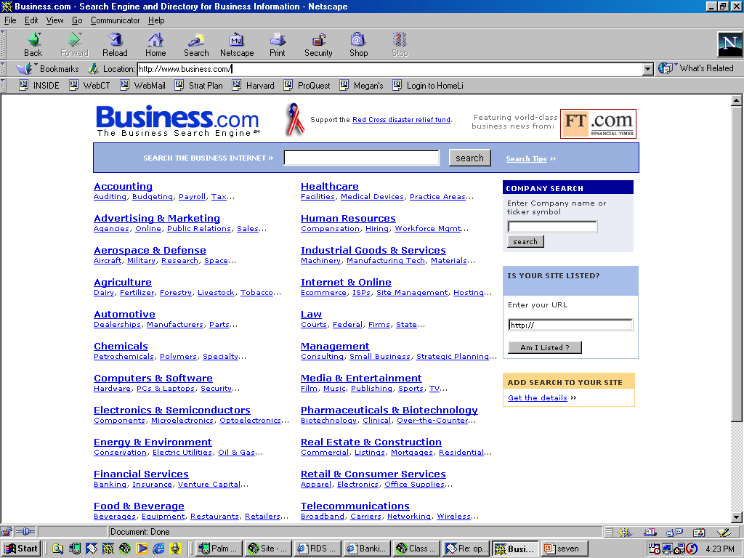
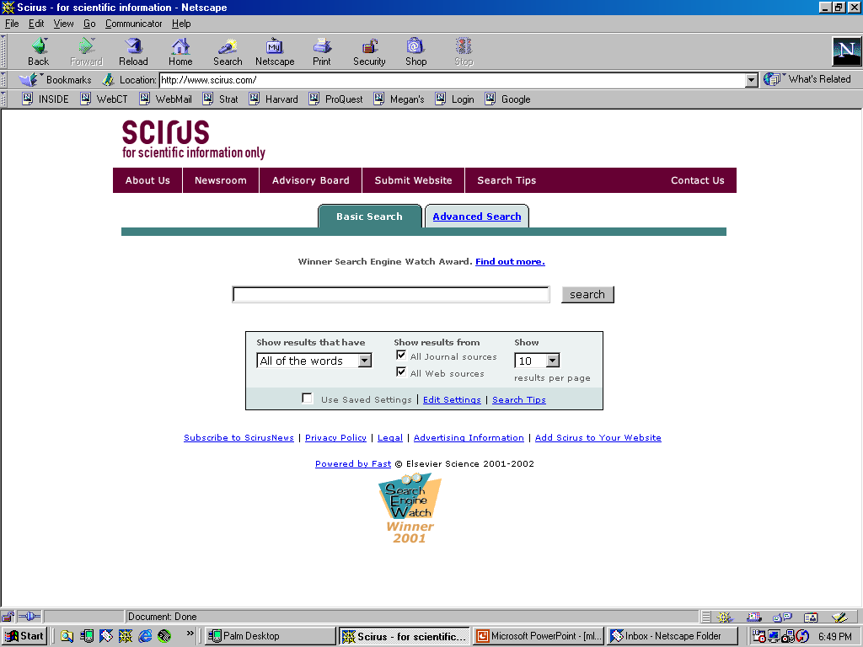
Motores de busca especializados
Centenas de motores de busca para todos os tópicos

Slide 23
Um motor de busca especialmente interessante
Shodan permite pesquisar por tipos específicos de computadores ligados à Internet
Routers, servidores, semáforos, câmaras de vigilância, sistemas de aquecimento para casas
Sistemas de controlo de estações de serviço, tratamento de águas, parques aquáticos, redes eléctricas, centrais nucleares, aceleradores de partículas
Porque é que é interessante?
Muitos dispositivos usam "admin" como username e "1234" como password, e só precisam de um browser para serem contactados

Slide 24
Como é que o Shodan funciona?
Recolhe dados sobretudo de servidores HTTP (porto 80)
Mas também FTP (21), SSH (22) Telnet (23), and SNMP (161)
“Google crawls URLs – I don’t do that at all. The only thing I do is randomly pick an IP out of all the IPs that exist, whether it’s online or not being used, and I try to connect to it on different ports. It’s probably not a part of the visible web in the sense that you can’t just use a browser. It’s not something that most people can easily discover, just because it’s not visual in the same way a website is.”
John Matherly, Shodan's creator
Notes:
Simple Network Management Protocol (SNMP) is a popular protocol for network management. It is used for collecting information from, and configuring, network devices, such as servers, printers, hubs, switches, and routers on an Internet Protocol (IP) network.

Slide 25
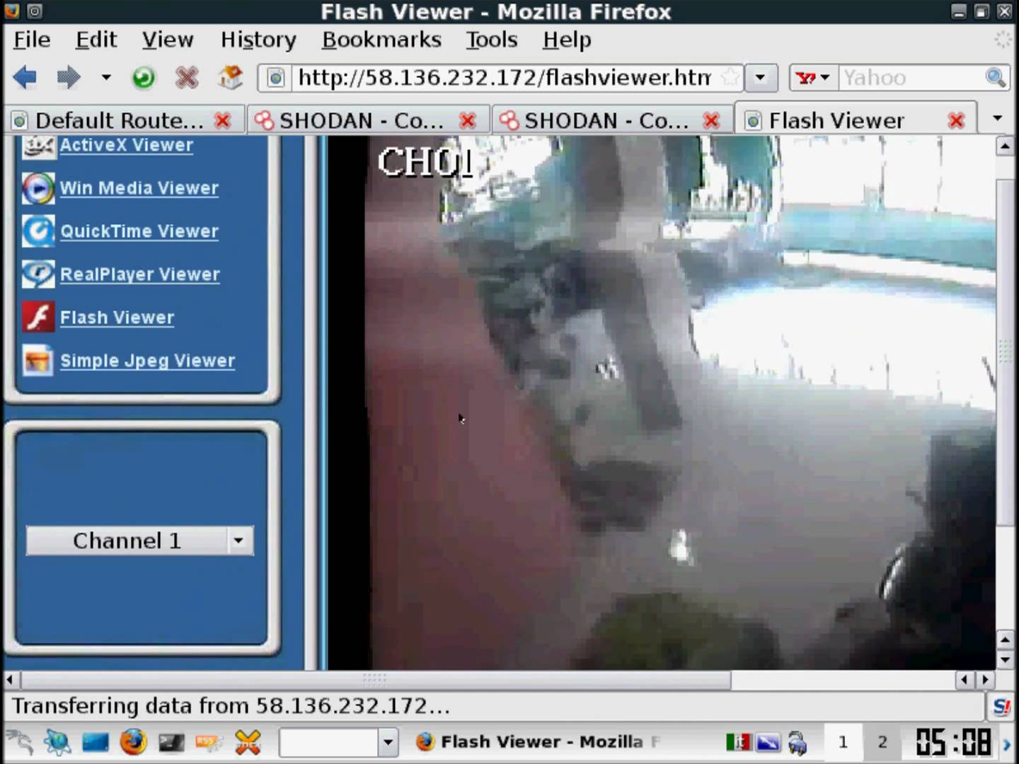
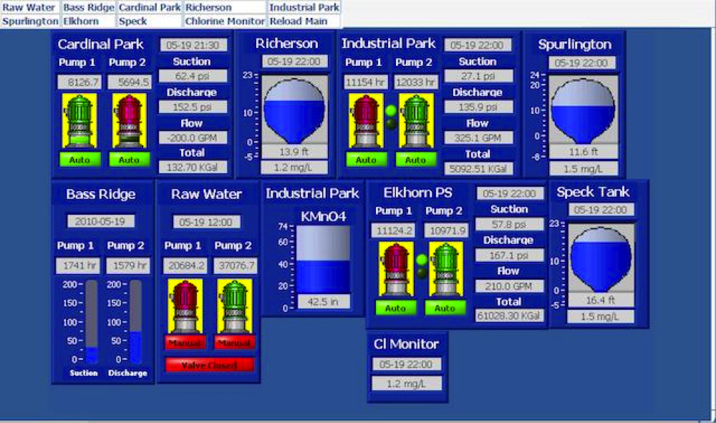
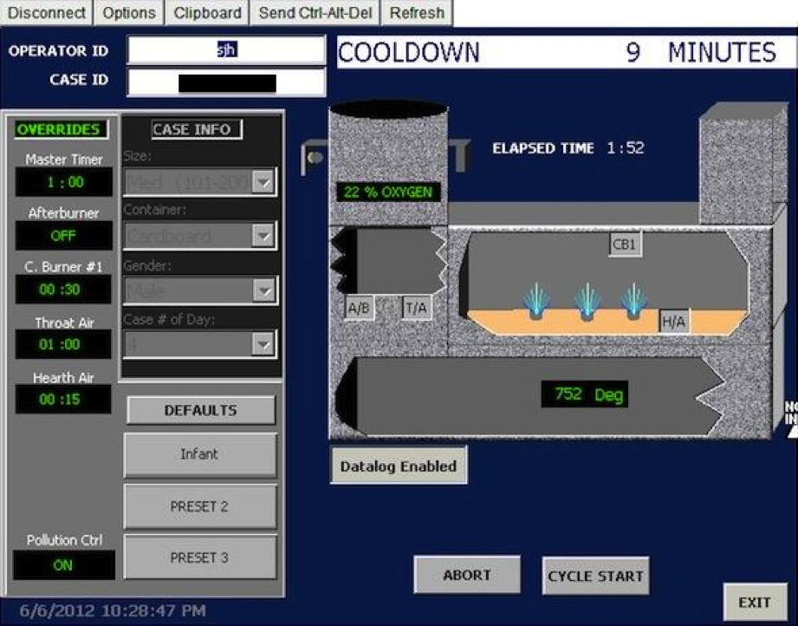
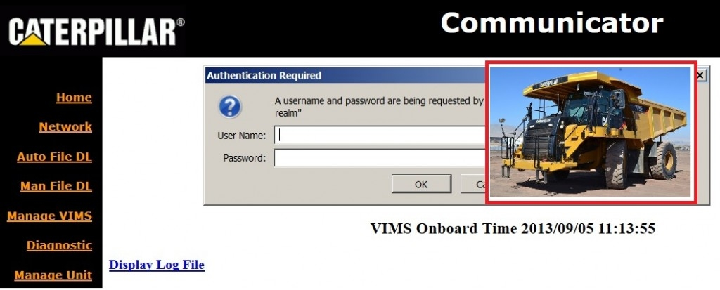
Coisas surpreendentes que podemos encontrar
Webcam
Controlos para tratamento de águas
Controlos de camiões
Controlos de um crematório

Slide 26
Mais no fundo encontramos a Dark Web
Dark Web constiste em conteúdos que existem em darknets
Darknets são redes próprias na Internet que requerem software específico para acesso e oferecem propriedades de anonimato
Montadas em redes peer-to-peer
Como hidden services sobre o Tor

Slide 27
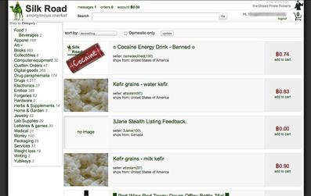
Dark Web: marketplace de actividades ilícitas
Serviços de piratearia informática
Serviços para realização de fraude e lavagem de dinheiro
Mercados de produtos ilegais (armas, drogas)
Pornografia infantil
Assassinos profissionais
…

Slide 28
Principais instrumentos do cibercrime
Deep Web
Como encontrar informação e localizer serviços
Ferramentas do Cibercrime
Sistemas de anonimato
Como esconder a ID na Internet
Botnets
Como lançar ataques em larga escala
Criptomoeda
Como tornar os pagamentos não rastreáveis

Slide 29
Anonimato online

Slide 30
Porquê ser anónimo na Internet?
Se for um cibercriminoso!
Infractor de direitos de autor, pirata, spammer, terrorista, etc.
Mas também se for:
Jornalista
Whistleblower
Activista de direitos humanos
Quadros executivos
Militares e agências de intelligence
Vítima de abuso
Notes:
Definição de comunicação anónima
Hiding the identitie(s) of the parties involved in digital communications from each other, or from third-parties
“Who you are” from the communicating party
“Who you are talking to” from everyone else

Slide 31
Na Internet é difícil ser totalmente anónimo
O teu endereço IP pode ser relacionado contigo
Os ISPs guardam registos das comunicações
Durante alguns anos (Data Retention Laws)
Esses registos podem ser obtidos por ordem judicial
O teu browser pode ser identificado e rastreado
Cookies, Flash cookies, HTML5 storage
Browser fingerprinting
As tuas actividades online podem identificar-te
Os sites web e apps únicos que usas
O tipo de links a que acedes

Slide 32
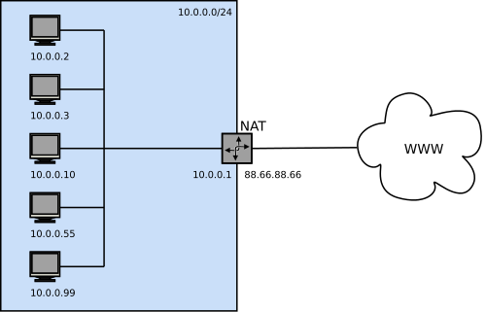
Exemplo da dificuldade de ser anónimo
A NAT esconde múltiplos clientes por detrás do mesmo IP
Como identificar esses clientes?
Se tiveres acesso à NAT, consultar a tabela de mapeamento
Caso contrário?...
?

Slide 33
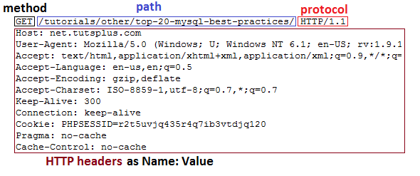
Browser fingerprinting
Recolha sistemática de informação sobre o browser
Pedido HTTP (user agent e accept headers)
Javascript API (ex.., plugins installados)
Flash plugin API (e.g., versão OS, lista de fontes, resolução de ecrã)
Elemento HTML5 Canvas (differenças em image rendering)
Notes:
https://amiunique.org/faq
Device fingerprinting or browser fingerprinting is the systematic collection of information about a remote device, for identification purposes. Client-side scripting languages allow the development of procedures to collect very rich fingerprints: browser and operating system type and version, screen resolution, architecture type, lists of fonts, plugins, microphone, camera, etc.
Browser fingerprints are also called “cookieless monsters” because it is not necessary to install any form of cookie to collect a fingerprint. This means that the act of fingerprinting a specific browser is stateless and transparent for the user. Any third-party interested in fingerprinting can exploit a set of different techniques to get a rich fingerprint:
- The user agent and the accept headers are automatically sent to websites when a connection is initiated.
- JavaScript gives access to many browser-populated features like the plugins installed on the user’s device.
- If the Flash plugin is installed, its rich programming interface (API) provides access to many system-specific attributes: exact version of the operating system, list of fonts, screen resolution, timezone.
- Through the display of an HTML5 Canvas element, it is possible to collect small differences in the hardware or in the software configurations, thanks to slight differences in the image rendering between devices. The smallest pixel difference can be detected. This is called canvas fingerprinting.

Slide 34
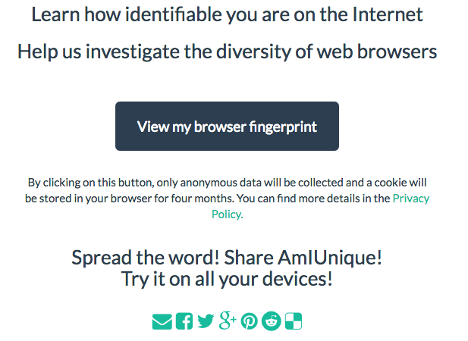
http://amiunique.org

Slide 35
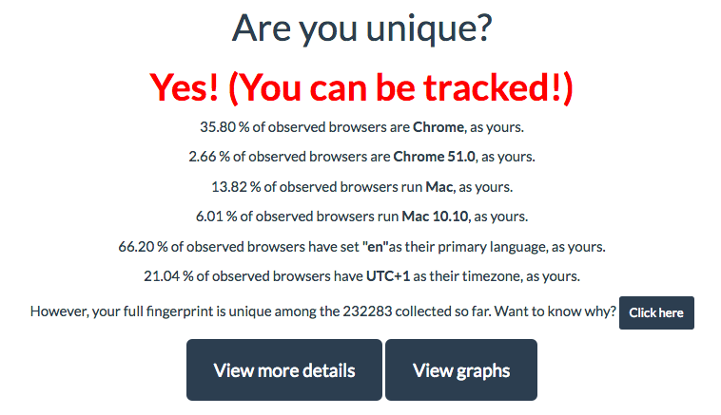
Results on my browser

Slide 36
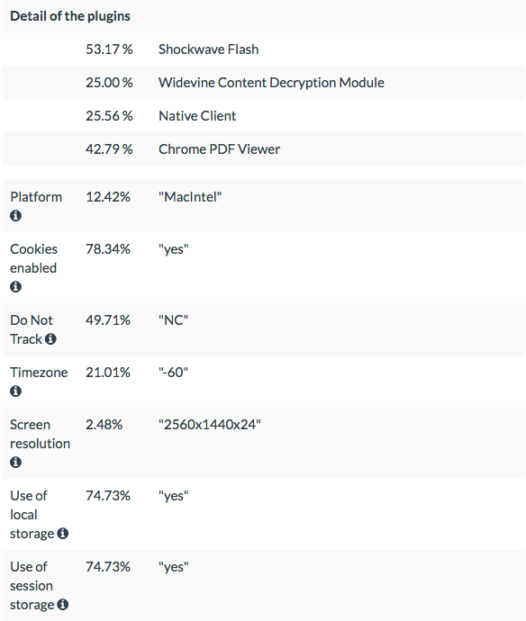
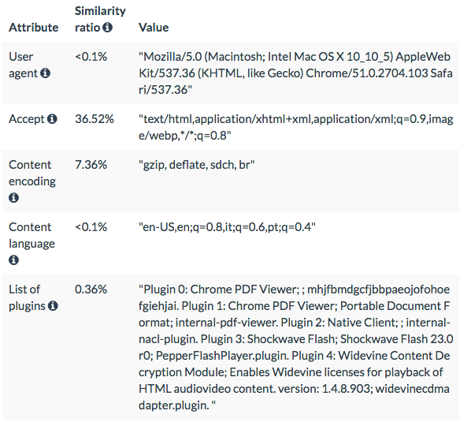
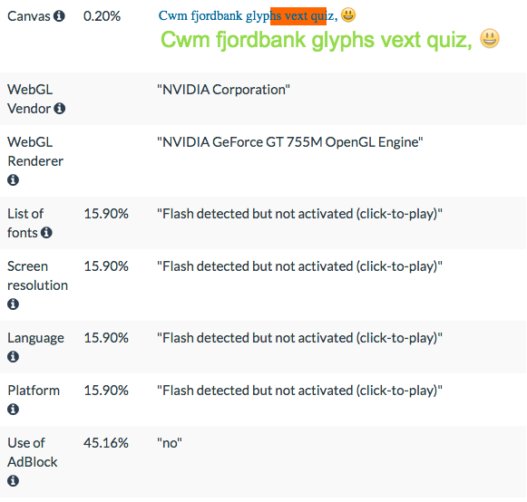
Perceber os detalhes desta identificação

Slide 37
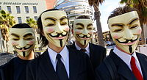


Anonymity systems
Procuram ocultar a identidade dos interlocutores das comunicações
Anonymity
System
Interlocutor B
Interlocutor A
?

Slide 38
Tipos de anonimato
Anonimato do remetente
Can’t tell who sent this message
Receiver anonymity
Can’t tell who received this message
Sender-receiver anonymity
Can’t tell if A and B are respectively the sender and receiver of this message

Slide 39













Quantifying anonymity
How can we calculate how anonymous we are?
Anonymity Sets
Larger anonymity set = stronger anonymity
Suspects (Anonymity Set)
Who sent this message?

Slide 40

Example where no anonymity exists
Encrypted data traffic (SSL)
Content is unobservable
Due to encryption
Source and destination are trivially linkable
No anonymity!

Slide 41








Basic approach: Anonymizing proxies
HTTPS Proxy
Web proxies are set up to allow forwarding of HTTPS traffic
e.g., https://www.anonymizer.com, http://www.bind2.com/
Notes:
http://security.stackexchange.com/questions/8145/does-https-prevent-man-in-the-middle-attacks-by-proxy-server

Slide 42
Investigating anonymizing proxies
HTTPS Proxy
Destination is known
Source anonymity

Slide 43
Investigating anonymizing proxies
HTTPS Proxy
Source is known
Destination anonymity

Slide 44
Investigating anonymizing proxies
HTTPS Proxy
No anonymity!

Slide 45

Similar properties for any anonymizing proxy
VPN Gateway
Source is known
Destination anonymity
Destination is known
Source anonymity
No anonymity!

Slide 46

Raising the bar: Anonymity loves company
Key mechanism of anonymity is blending and obfuscation
Were’s Wally?

Slide 47
Anonymity network
Aim to overcome limitations of public proxy server, i.e:
The proxy owner can be forced to reveal stored logs
Worse, the server may turn out to be a honeypot
Anonymity network: forward traffic through a chain of network nodes, so-called relays
Popular anonymity networks: Tor, I2P
Tor adopts some ideas from onion routing

Slide 48


Onion routing protocols
Use public-key cryptography to establish a “circuit” with pairwise symmetric keys between hops on the circuit
Sender chooses sequence of routers: some may be honest some controlled by an investigator; sender controls length of path
Then use symmetric decryption and re-encryption to move data messages along the established circuits
R
R
R₄
R
R₃
R
R₁
R
R₂
R

Slide 49
Route establishment in basic onion routing
R₂
R₄
R₃
A
R₁
B
{M}_{pk(B)}
Routing info for each link encrypted with router’s public key
Each router learns only the identity of the next router

Slide 50
Route establishment in basic onion routing
R₂
R₄
R₃
A
R₁
B
{M}_{pk(B)}
{B,k₄}_{pk(R4)},{ }_{k4}
Routing info for each link encrypted with router’s public key
Each router learns only the identity of the next router

Slide 51
Route establishment in basic onion routing
R₂
R₄
R₃
A
R₁
B
{M}_{pk(B)}
{B,k₄}_{pk(R4)},{ }_{k4}
{R₄,k₃}_{pk(R3)},{ }_{k3}
Routing info for each link encrypted with router’s public key
Each router learns only the identity of the next router

Slide 52
Route establishment in basic onion routing
R₂
R₄
R₃
A
R₁
B
{M}_{pk(B)}
{B,k₄}_{pk(R4)},{ }_{k4}
{R₄,k₃}_{pk(R3)},{ }_{k3}
{R₃,k₂}_{pk(R2)},{ }_{k2}
Routing info for each link encrypted with router’s public key
Each router learns only the identity of the next router

Slide 53
Route establishment in basic onion routing
R₂
R₄
R₃
A
R₁
B
{M}_{pk(B)}
{B,k₄}_{pk(R4)},{ }_{k4}
{R₄,k₃}_{pk(R3)},{ }_{k3}
{R₃,k₂}_{pk(R2)},{ }_{k2}
{R₂,k₁}_{pk(R1)},{ }_{k1}
Routing info for each link encrypted with router’s public key
Each router learns only the identity of the next router

Slide 54
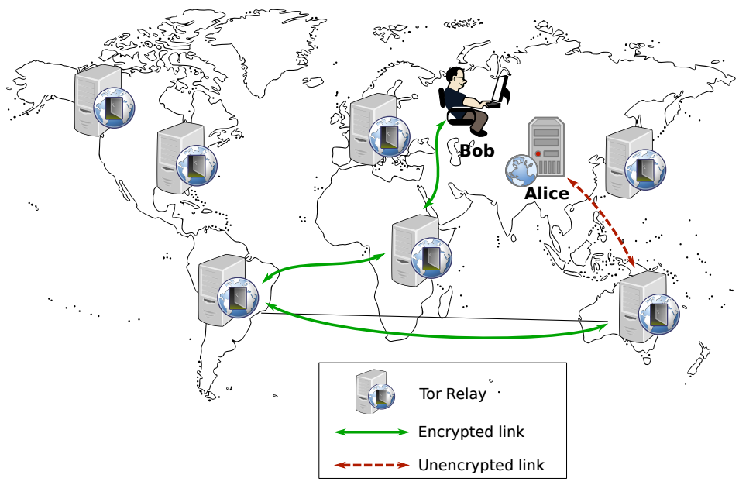

Tor: The 2nd generation onion router
Tor is a volunteer-based low-latency anonymity network
Anonymizes user traffic by forwarding it through a circuit of relays
Each relay in the circuit knows only the immediate transmitter of the message and the immediate receiver of the message
Using Tor makes it more difficult for non-global adversaries to trace Internet activity for TCP applications
Notes:
“If you’re not doing anything wrong, you shouldn’t have anything to hide.”
Do you agree?
Who else uses Tor?
Journalists
Law enforcement
Human rights activists
Normal people
Fact: Tor was/is developed by the Navy

Slide 55

How to use Tor?
Download, install, and execute the Tor client
The client acts as a SOCKS proxy
The client builds and maintains circuits of relays
Configure browser to use the Tor client as a proxy
Any app that supports SOCKS proxies will work with Tor
All traffic from the browser will now be routed through the Tor overlay
Tor circuit establishment uses ideas of onion routing
Notes:
A SOCKS server is a general purpose proxy server that establishes a TCP connection to another server on behalf of a client, then routes all the traffic back and forth between the client and the server. It works for any kind of network protocol on any port. SOCKS Version 5 adds additional support for security and UDP.

Slide 56

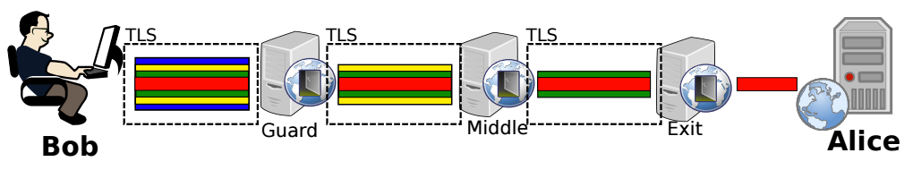

Tor circuit establishment: Relay selection
When Bob wants to connect to Alice through Tor, he downloads the Consensus from the Tor authorities
Nine Tor authorities maintain the list of other Tor relays
List of Tor relays is named Consensus
Bob randomly chooses three Tor relays from the list
Each Tor relay is uniquely identified by an RSA public key
Tor Authorities
Consensus
Notes:
Tor is a semi-decentralized network comprising:
Tor relays which forward client traffic
Nine Tor authorities which maintain the list of other Tor relays and distribute this list to clients
The IP addresses of authorities and their public keys are hard-coded into the Tor code
The list of Tor relays is named Consensus
Each Tor relay is uniquely identified by an RSA public key
The list of all Tor relays is distributed by the Tor authorities in the consensus document
The consensus is updated once an hour by the directory authorities and remains valid for three hours
Every consensus document has a “valid-after” (VA) time, a “fresh-until” (FU) time and a “valid-until” (VU) time
The consensus is considered fresh for one hour (until “fresh-until” has passed) and valid for two hours more (until “valid-until” has passed)

Slide 57
Tor circuit establishment: Connect to 1st relay
A Tor client builds a circuit one hop at a time
Bot sets up a TLS connection with the Entry node
Negotiates a Diffie-Hellman (DH) key with first node in path
TLS connection
Key negotiation with first node (blue)
Entry
Layered encryption

Slide 58
Tor circuit establishment: Connect to 2nd relay
Then complete a DiffieHellman key exchange handshake with the second node by using the first node as a proxy
The middle node does not know the real initiator of the handshake
TLS connection
Key negotiation with second node (yellow)
Entry
Layered encryption

Slide 59
Tor circuit establishment: Connect to 3rd relay
Repeat the same procedure with the third node but use the chain of entry and middle nodes as proxies
TLS connection
Key negotiation with third node (green)
Entry
Layered encryption

Slide 60
Data transmission
To connect to a server on the Internet, the client:
packs his messages in fixed 512-bytes sized cells
encrypts each cells with the three relay keys
Each relay strips off one layer of encryption
Breaks linkability between the sender and the destination
Normally, messages also encrypted using end-to-end protocol
Data transmission (red)
Entry
Layered encryption

Slide 61
Hidden services
Tor is very good at hiding the source of traffic
But the destination is often an exposed website
What if an offender wants to run an anonymous service?
i.e. a website, where nobody knows the IP address?
Tor supports Hidden Services
Allows for running a server and have people connect
… without disclosing the IP or DNS name
Many hidden services
Tor Mail, Tor Char
DuckDuckGo
The Pirate Bay
Silk Road (2.0)
Notes:
https://www.torproject.org/docs/hidden-services.html.en

Slide 62



Hidden service example
Hidden
Service

Slide 63
Hidden service example
Introduction Points
Hidden
Service

Slide 64
Hidden service example
https://go2ndkjdf8whfanf4o.onion
Hidden
Service
Onion URL is a hash, allows any Tor user to find the introduction points
Notes:
https://www.torproject.org/docs/hidden-services.html.en

Slide 65
Hidden service example
https://go2ndkjdf8whfanf4o.onion
Hidden
Service
Rendezvous Point

Slide 66

Hidden service example
Introduce
message
https://go2ndkjdf8whfanf4o.onion
Hidden
Service
Rendezvous Point

Slide 67
Hidden service example
https://go2ndkjdf8whfanf4o.onion
Hidden
Service
Rendezvous Point

Slide 68
Principais instrumentos do cibercrime
Deep Web
Como encontrar informação e localizer serviços
Ferramentas do Cibercrime
Sistemas de anonimato
Como esconder a ID na Internet
Botnets
Como lançar ataques em larga escala
Criptomoeda
Como tornar os pagamentos não rastreáveis

Slide 69
Botnets

Slide 70
Botnet security threats
Cyber attack sophistication vs. cyber criminal sophistication
bots
Cross site scripting
Tools
“stealth” / advanced scanning techniques
High
Staged attack
packet spoofing
denial of service
Intruder
Knowledge
sniffers
distributed
attack tools
sweepers
www attacks
automated probes/scans
GUI
back doors
disabling audits
network mgmt. diagnostics
hijacking
sessions
burglaries
exploiting known vulnerabilities
Attack
Sophistication
password cracking
self-replicating code
Attackers
Low
password guessing
1980
1985
1990
1995
2000+

Slide 71
What is a botnet?
Botnet: a collection of software “robots” that run on host computers autonomously and automatically, controlled remotely by an attacker or attackers
Truly effective as an online weapon for terrorism
i.e. perform targeted attacks on governments and infrastructure
Primary means for malicious activity:
E.g., launching denial-of-service attacks (DDoS)
Notes:
Stealing personal data such as mail accounts, intellectual property, military secrets, embarrassing information or bank credentials

Slide 72
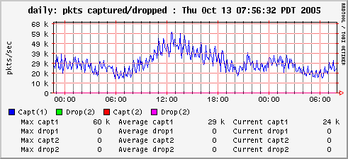
DDoS attacks
Goal: to overwhelm victim machine and deny service to its legitimate clients
Packet graph at a server looks like this normally:

Slide 73
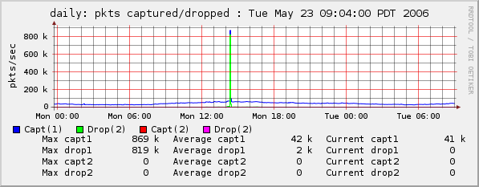
DDoS attacks
Goal: to overwhelm victim machine and deny service to its legitimate clients
Here, we’re under attack: that’s 869K pps

Slide 74

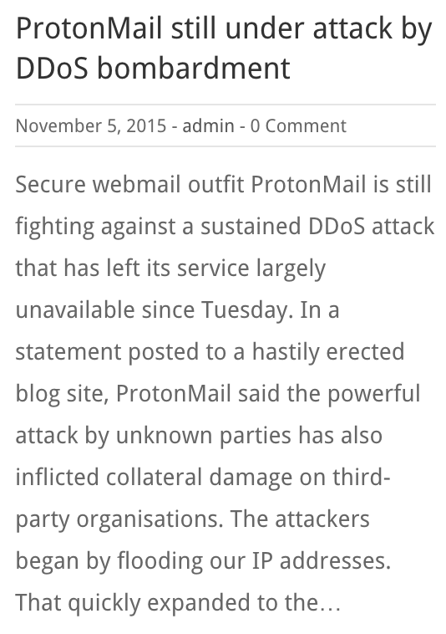
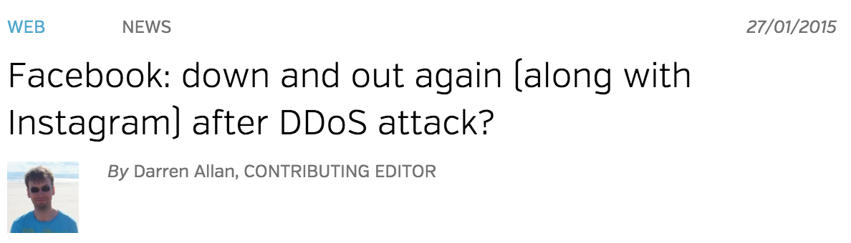
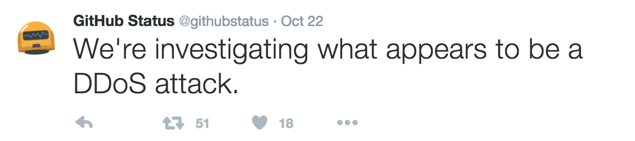
Real world reports of DDoS attacks
From the Twitter blog:

Slide 75


Launching DDoS attacks through a botnet
Attacker
Master machines
Zombie machines
Victim

Slide 76
Botnet activities
DDoS attacks
Data theft
Phishing
Spam
Click fraud
Scan vulnerabilities
…
Notes:
Used by online criminals to make money
Extortion
“Pay use $100K or we will DDoS your website”
Spam and click-fraud
Phishing and theft of personal information
Credit card numbers, bank login information, etc.

Slide 77
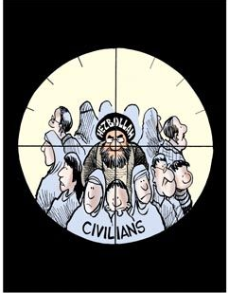
Why are botnets such a powerful tool?
1. Huge scale
2. Hard to defeat
Thousands or millions of zombies
Zombies are part of the crowd
Botnet | Estimated size
Conficker (2008) | 10.500.000
BredoLab (2009) | 30.000.000
Ramnit (2011) | 3.000.000
Torpig | 180.000
Storm | 160.000
Asprox | 15.000
3. Easy to manage

Slide 78
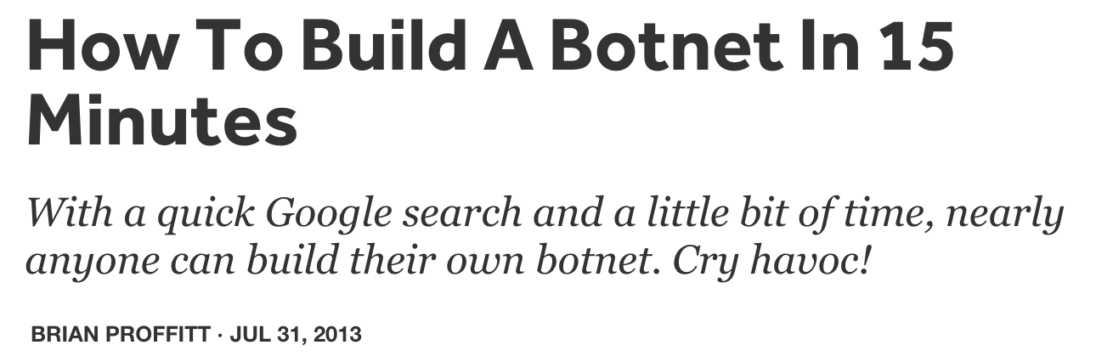
How easy is it to build a botnet?
Botnet kits readily available online for all wallets
Notes:
http://readwrite.com/2013/07/31/how-to-build-a-botnet-in-15-minutes
https://www.fireeye.com/blog/executive-perspective/2013/08/cybercriminal-intent-how-to-build-your-own-botnet-in-less-than-15-minutes.html

Slide 79
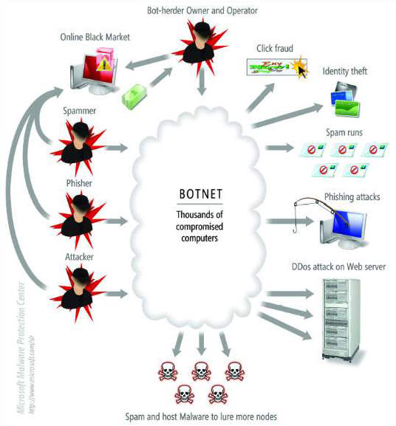
A global botnet market
Botmasters are not necessarily (only) botnet’s end-beneficiaries
Who pays:
Internet Advertising companies for downloading adware onto vulnerable PCs
Companies who send spam, viruses and other malware
…

Slide 80
Botnet recruiting: The big picture
Command and Control (C&C) server
(*) : Optional Step
Notes:
A command-and-control [C&C] server is a computer controlled by an attacker or cybercriminal which is used to send commands to systems compromised by malware and receive stolen data from a target network.
https://www.trendmicro.com/vinfo/us/security/definition/command-and-control-server

Slide 81
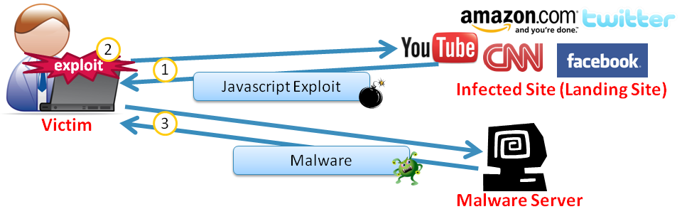
Methods of infecting botnet nodes
Email
Pirated software
Drive-by download
Notes:
Email
A more traditional yet still popular method of botnet infection is through a user opening email with malicious content, often sent by someone the user knows and trusts (whose system is likely infected with a botnet)
Pirated software
Malware developers often hide malicious code inside a software download, which then installs itself on a victim’s machine when the user opens the executable
Drive-by download
Visiting a malicious site with a PC that hasn’t been kept current with security patches and antivirus can download and execute malware on the user’s PC, thus adding to that botnet’s ranks

Slide 82
Trends in botnet design
Botnets tend to be as specific as possible to the task they are assigned to do, e.g.,
spam-only (Conficker) and DDoS-only (Mariposa) botnets
multipurpose botnets, like the Zeus botnet, are decreasing
Large botnets will be aggressive in capturing more computers for their kingdom
SpyEye botnet has an option "Kill Zeus" to disinfect the computer from Zeus malware

Slide 83
Trail obfuscation techniques
Encryption
Botnet malware is encrypted to avoid detection by signature-based IDS
Rootkits
To hide processes, data, or activities on a compromised system
Piggyback on existing protocols and systems
E.g., IRC, HTTP, etc.
Fast Flux and Domain Generation Algorithms (DGA)
To ensure the bot is always able to communicate with its C&C server
P2P botnet architectures
To avoid single point of detection / failure

Slide 84

Centralized C&C architecture
Botmaster
IRC Servers

Slide 85

Centralized C&C architecture: IRC channels
snd spam: <subject> <msg>
Botmaster
snd spam: <subject> <msg>
snd spam: <subject> <msg>
IRC Servers

Slide 86
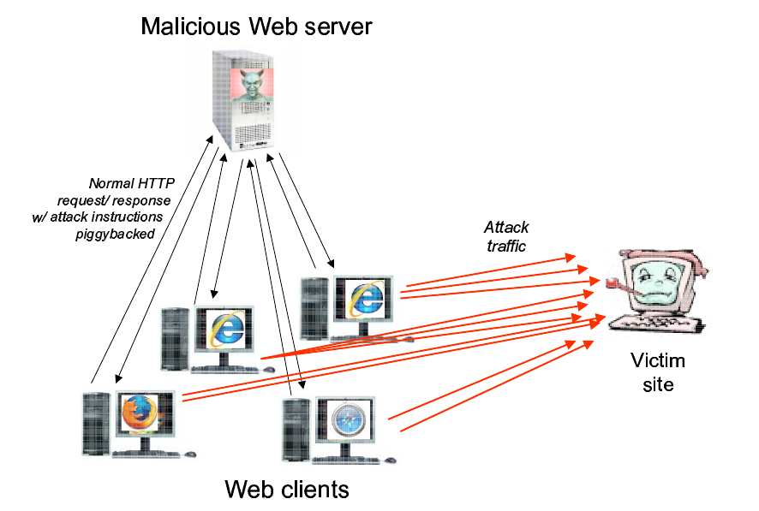
Using HTTP
If HTTP is used, bots query dedicated web sites regularly for getting new commands

Slide 87
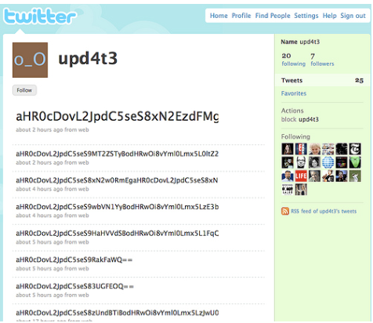
Web services
Social networks becoming the command points for botnets
Botnets targeting industrial systems and mobile devices

Slide 88
Fast flux
Botmaster
HTTP Servers
12.34.56.78
6.4.2.0
31.64.7.22
245.9.1.43
98.102.8.1
www.my-botnet.com
Change DNS→IP mapping every 10 seconds
Notes:
Misconception: since bots connect w/ C&C server, existing tools are able to block the connection
To evade existing methods of blocking access the server, some botnets maintain a list of IPs with which to connect
More advanced botnets use fast flux: IP addresses are rotated against the same domain
Bot master points many IP addresses to the domain names the bot attempts to contact
By changing those records regularly, the bot master ensures they can stay a step ahead of potential actions to shut down the server

Slide 89
Fast flux IP addresses used by a bot
Example of IP addresses that are rotated in seconds against the same domain:
[QUESTION] Website name:
www.lijg.ru
[ANSWER] IP Addresses:
www.lijg.ru → 68.124.161.76
www.lijg.ru → 69.14.27.151
www.lijg.ru → 70.251.45.186
www.lijg.ru → 71.12.89.105
www.lijg.ru → 71.235.251.99
www.lijg.ru → 75.11.10.101
www.lijg.ru → 75.75.104.133
www.lijg.ru → 97.104.40.246
www.lijg.ru → 173.16.99.131
…………………

Slide 90
Thwarting fast flux
Botmaster
HTTP Servers
12.34.56.78
6.4.2.0
31.64.7.22
245.9.1.43
98.102.8.1
But: ISPs can blacklist the rendezvous domain
www.my-botnet.com

Slide 91
Domain Generation Algorithms
DGA: a method in which the malware generates the C&C server address
The malware can determine when to connect to what appears to be a random address online
Bot master ensures random domain name was registered ahead of connection time and created appropriate DNS records to point that address to their C&C server
Examples of random
addresses
eqxowsn.info
ggegtugh.info
hquterpacw.net
oumaac.com
rwyoehbkhdhb.info
rzziyf.info
vmlbhdvtjrn.org
…

Slide 92
Random domain generation
Botmaster
HTTP Servers
www.sb39fwn.com

Slide 93
Random domain generation
Botmaster
HTTP Servers
www.17-cjbq0n.com

Slide 94
Random domain generation
Botmaster
HTTP Servers
www.xx8h4d9n.com

Slide 95
Random domain generation
Bots generate many possible domains each day
Botmaster
…But the Botmaster only needs to register a few
HTTP Servers
www.sb39fwn.com
www.17-cjbq0n.com
www.xx8h4d9n.com
Can be combined with fast flux

Slide 96
P2P Botnets
Structured P2P DHT
Botmaster
Master Servers

Slide 97

P2P Botnets
Structured P2P DHT
Botmaster
Master Servers

Slide 98
P2P Botnets
Insert commands into the DHT
Structured P2P DHT
Botmaster
Master Servers

Slide 99
P2P Botnets
Structured P2P DHT
Botmaster
Master Servers
Get commands from the DHT
Notes:
Resiliencia / latência

Slide 100
Principais instrumentos do cibercrime
Deep Web
Como encontrar informação e localizer serviços
Ferramentas do Cibercrime
Sistemas de anonimato
Como esconder a ID na Internet
Botnets
Como lançar ataques em larga escala
Criptomoeda
Como tornar os pagamentos não rastreáveis

Slide 101
Conclusions
Botnets are amongst the most advanced tools for carrying out cybercrime (e.g., DDoS, data theft, spam)
To evade detection, botnets employ highly sophisticated techniques, such as P2P architectures, fast flux, DGA, encryption, etc.
Detecting and deterring botnets is a very challenging task and an active topic of security research

Slide 102
Conclusions
Anonymity systems enable general users to preserve their privacy online, but can be used for criminal purposes
Overtime, anonymity systems have evolved so much that that it is hard for forensic investigators to thwart them, notably Tor
Despite the advanced techniques employed by these systems, however, there are weaknesses that allow for user de-anonymization techniques to be successfully employed

Slide 103
Conclusões
Segurança forense desempenha um papel cada vez mais relevante na recolha de prova para resolução de processos judiciais
Deve ser conduzida de forma extremamente rigorosa por forma a preservar a admissibilidade de prova em tribunal
Para adquirir prova digital de sistemas de computadores, é necessário ter muitos factores em conta, por exemplo se se deve desligar o cabo de alimentação ou de rede

